Slide 1
Information Model Integration
Recommendations
“CIMI+FHIM+SOLOR+CQF Integration”
CIMI Sponsored HL7 Investigative-Study, Task Force and
ONC, FHA, IPO DOD VA sponsored HIEA Technical Forum
for Core Information Modeling SMEs
Report Out
September 7, 2016 FHA Managing Board
September 18-22, 2016 HL7 Meeting
Presented by:
Nona Hall, Steve Wagner, Steve Hufnagel

Slide 2
Agenda
Approach
Goal
Problem/Current State
Objectives
Recommendations
High Level WBS - Pilot Considerations
Attributes of Success

Slide 3
Approach: Integration/Convergence
Key to Success: Drawing upon our strong SME base!
Where We’ve Been?
FHIM Value / Evaluation, report provided Jun 2016 FHA Managing Board
FHIM-CIMI Investigative Study presented Jan 2016 HL7 Wkgp Meeting
Core SME Framework established. SubTask Force initiated, Mar 2016
FHA, DoD/VA IPO and ONC/OST co sponsorship obtained
May 2016 HL7 Wkgp Meeting leveraged to develop outline supportive of two-day event; select means (IPO HIEA Technical Forum)
SME Prep Sessions conducted to discuss/negotiate going forward efforts
Pre-Education Seminars
Aug 17-18, 2016 Information Modeling Technical Forum
Education, Collaboration & Commitments between Stakeholders
Detailed Agenda Walk Through
Recommendations & Next Steps
Present Findings / Recommendations via 7 Sep 2016 FHA Managing Board
Discuss Findings/Recommendations via 18-21 Sep 2016 HL7 Meeting; identify Next Steps
Engage Communities to identify pilots / associated resources

Slide 4
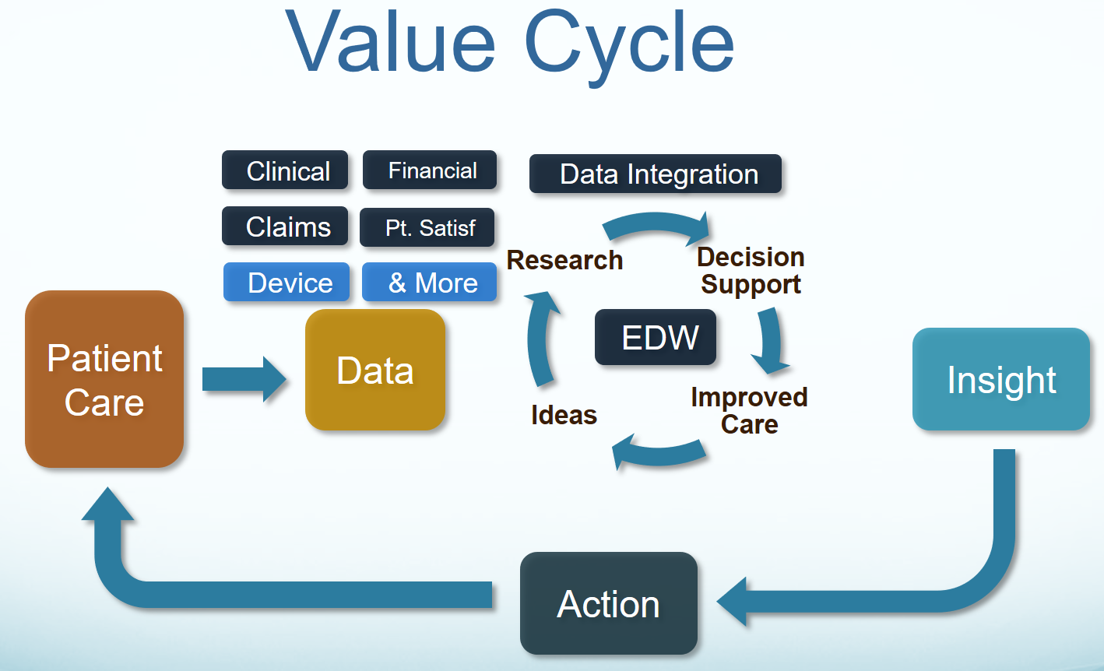
Goal
Our goal is “To help people live the healthiest lives possible;” where, the foundation of a Learning Healthcare System is accurate, computable, data starting with the integration of CIMI, FHIM, SOLOR, CQF and other Information Models into a widely used HL7/ISO standard ^{[Stan Huff]}.

Slide 5

Problem: Skyscraper Analogy
As-Is
To-Be
Not Harmonized
Not Harmonized
Harmonized
Shared Meaning
No shared terminology model or information model - not interoperable
No shared terminology model, shared information model - not interoperable
Shared terminology model and information model - interoperable future state
*Drawn from Dr. Keith Campbell’s analogy used within The Open Group Healthcare Forum (HCF) article:
Advancing Healthcare Interoperability www.opengroup.org/bookstore/catalog/w16a.htm
Notes:
BLUF (Bottom Line Up Front)
As is: no shared terminology content (floor 1), no shared information models (floor 2), then they are building from the 3rd floor up. No shared value from the 3rd floor up.
Future State: shared terminology content (floor 1), shared information models (floor 2), sharable value built on floors above.
In a perfect world the following would be done concurrently and with close collaboration
Recommended Solution Part 1: We integrate SOLOR into FHIM
Concurrently, resolving SOLAR gaps
Recommended Solution Part 2: We integrate CIMI, FHIM and CQF
Recommended Solution Part 3: We follow Agile refinement cycles through pilots and implementations
Recommended Solution Part 3: We develop adequate documentation, test cases, fixtures and supporting resources
In the real world, we are asking:
the Federal Partners to provide resources to make efficient and effective progress in the near, mid and long term.
the Federal Partners to work together to deliver—in an ongoing way—a single integrated terminology system (SOLOR), that meets all US regulatory requirements, while simplifying implementation for developers.
the FHA to facilitate Federal Partner governance and configuration management of this work
Ths ONC OTS to endorse this initiative and facility resources
We are asking the IPO to provide coordination and facilitation
We are asking HL7 to facilitate
international, commercial and academic peer review and
ballot governance and configuration management.
Coordination of an ISO ballot (this will be several years from now)
Analogy of the Challenge: Today’s efforts occur as if we’re always trying to build the ultimate skyscraper, starting on the 3rd Floor.
Inconsistencies exist/become extended producing transformational (mapping) efforts = models, models everywhere
The problem is that today’s healthcare systems do not capture information and its context consistently, and consequently, they cannot easily share-or-merge information from different sources to create a computable operational-picture (aka longitudinal patient-records, care plans, clinical knowledge and other shared healthcare information across time, multiple care locations and differing contexts).
If continued and unchecked, even the best of implementation accelerators, like FHIR with its extensions and profiles, allow far too much implementation variation; where, each project often creates, from scratch, yet, another information model, e.g. through a mapping exercise.
The missed opportunity is to leverage a shared logical Reference Information Model minimizing the duplicative-work, avoiding inconsistencies and avoiding the necessity to engage these SMEs, these resources and our larger community. This is the “models, models everywhere phenomenon ”. As an example,
Standards, in general, use different formats and rules for ‘simple’ things like: name, address, dates. Resulting in EHR-systems that after decades cannot uniformly exchange this ‘simple’ ubiquitous data; let alone ‘complex’ clinical health data.
the HL7 EHR Interoperability workgroup, in its analysis “Record Entry Lifecycle Event Metadata using FHIR,” found substantial provenance (who, what, when, where and how) inconsistencies among FHIR resources .
http://wiki.hl7.org/index.php?title=EHR_Interoperability_WG
The SOLOR/LEGO team found FHIR tries to define things such as attributes for anatomy, that are not based on a particular model of anatomy, and thus you get semantic overlap, with the burden of reconciliation, which may not even be possible, if left to the end user.

Slide 6
Problem Statement / Current State
The problem is that today’s systems do not capture the same information in the same way, and consequently, cannot easily share information or merge information from different sources to create a harmonized, operational picture of a patient across multiple care locations and contexts.
Notes:
Mapping alone does not work: If continued and unchecked, even the best of implementation accelerators, like FHIR with its extensions and profiles, allow far too much implementation variation; where, each project often creates, from scratch, yet, another information model, e.g. through a mapping exercise. The missed opportunity is to leverage a shared CLIM minimizing duplicative-work, avoiding inconsistencies and avoiding the necessity to engage these SMEs, these resources and our larger community. This is the “Models/Standards, Models/Standards Everywhere Conundrum”. As an example,
Standards use different formats and rules for ‘simple’ things like: name, address, dates or gender. Resulting in EHR-systems that after decades cannot uniformly exchange this ‘simple’ ubiquitous data; let alone ‘complex’ clinical health data.
the HL7 EHR Interoperability workgroup, in its analysis of “Record Entry Lifecycle Event Metadata using FHIR,” found substantial provenance (who, what, when, where and how) inconsistencies among FHIR resources.
The SOLOR and LEGO team found FHIR tries to define things such as attributes for anatomy, that are not based on a particular model of anatomy, and thus you get semantic overlap, with the burden of reconciliation, which may not even be possible, if left to the end user.

Slide 7
Objectives
Models need to be accepted as the foundation of interoperability
Pursue the Integration of SOLOR+FHIM+CIMI+CQF=CLIM set of harmonized models, as the Enabling Foundation to jump start initiatives
Integrate tooling to support models to extend the utility of these assets
Use models and tools to generate standards and implementation artifacts.
Advance in constructive steps through pilots and agile developments

Slide 8
Guiding Principles…..a Starting Point
The modeling SMEs recommend adding the following foundational principles:
A clean separation of clinical model semantics
using SNOMED, LOINC and RxNORM
CIMI’s existing Terms-of-Reference AKA Principles and modeling style guidelines result in CIMI Model, which is a clear, complete, concise, correct and consistent logical semantic-and-syntactic description of a healthcare concept, which can be instantiated as a computable implementation object that is interoperable among systems.
Notes:
Guiding Principles
Benefit: Organizes the manner resources interact to help minimize inconsistencies emphasizing SOLOR as base

Slide 9
Demonstrate the Viability of Integration Via Pilots
Identify the Project with willing parties that will implement the outputs for the Project
Identify the data elements needed to support the project
Identify the FHIM classes that support the data elements
Make the detailed CIMI models utilizing SOLOR for the source of terminology / vocabulary
Approve the model
Place model in a registry that is publicly available
Make the application via use of FHIR Profiles
Test the application for compliance with the model and standards
Put the application in production use & evaluate its value
General: Make people available; EHR behind that also available
Parallel Activities: Install a SOLOR Terminology Server; Need to harmonize models & tools

Slide 10

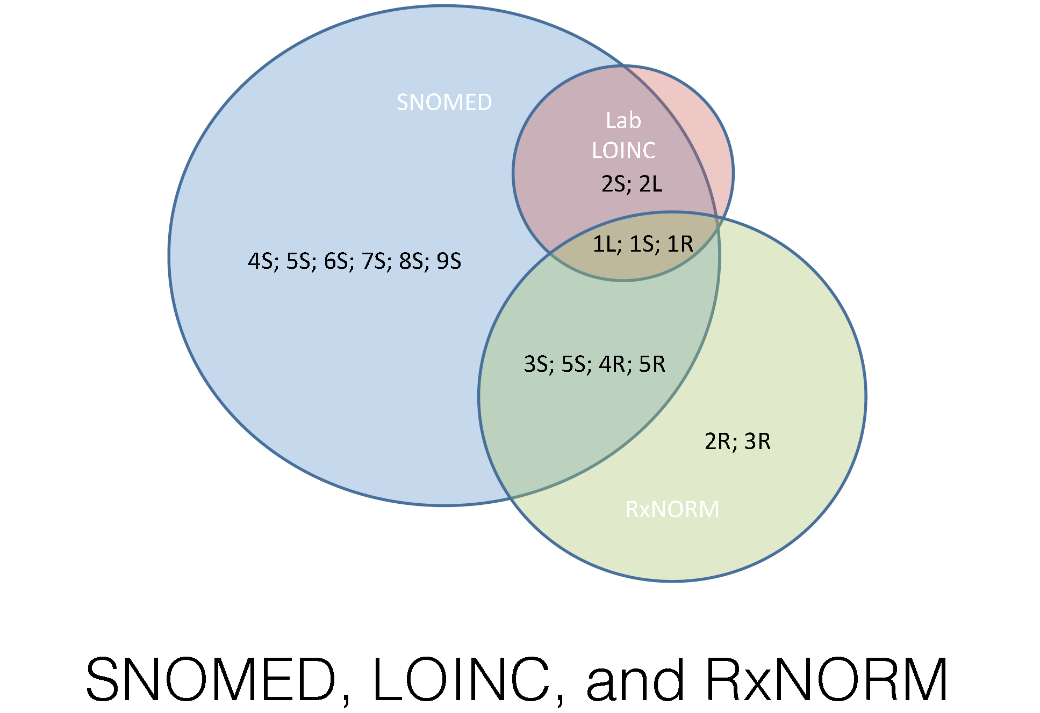
Proposed Solution: Step 1 Terminology Foundation
Terminology Problem SOLOR Solution
Serving as Terminology Foundation
SOLOR Benefits: Normalized structure and form of clinical terminology improves software reuse, shared tooling, reduced learning curve, shared post-coordination models, simplified data analysis … no more mapping!

Slide 11
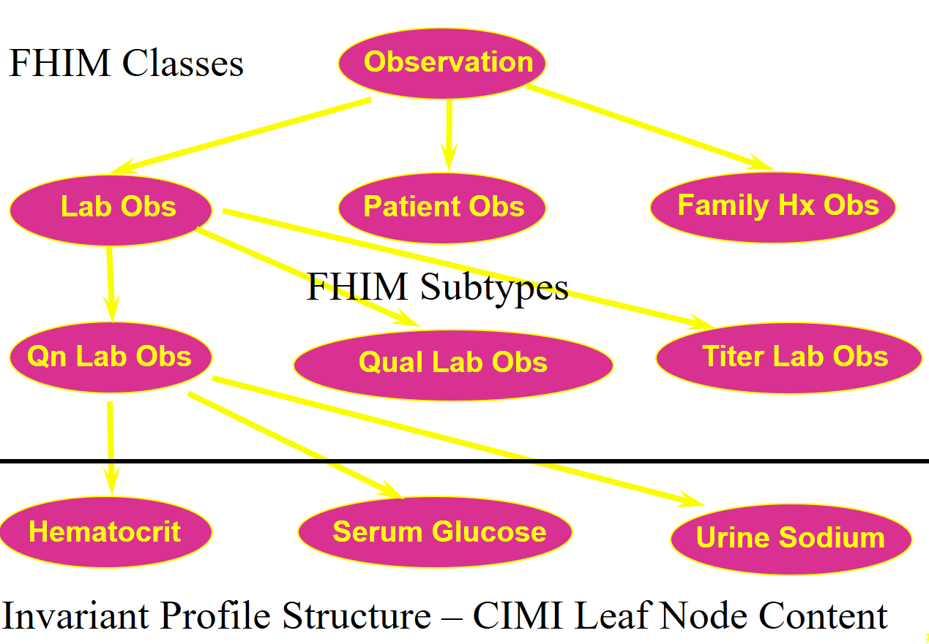
Clinical Example: CIMI-FHIM Integration
CQF Knowledge Artifacts
SOLOR Terminology

Slide 12

Proposed Solution: Step 2 Integrated Model Stack - Each Plays a Role
DCM
DCM
DCM
DCM
DCM
DCM
DCM
DCM
CQI
C QF
CDS
DCM
DCM
P C
DCM
Other
Initiatives
CIMI
FHIM
DCM
DCM
SOLOR
Notes:
No one asset can address the need. Each asset offers a unique contribution; SOLOR offers the terminology base; FHIM, the trunk of the tree; CIMI, CQF, etc. the leaves on the tree; FHIR accelerates implementation; tooling makes models meaningful to implementers
Circumstances are conducive: licensing flexibility; current state of each asset individually warrants a new (shared) vision
Integration brings together/streamlines efforts/creates efficiencies

Slide 13
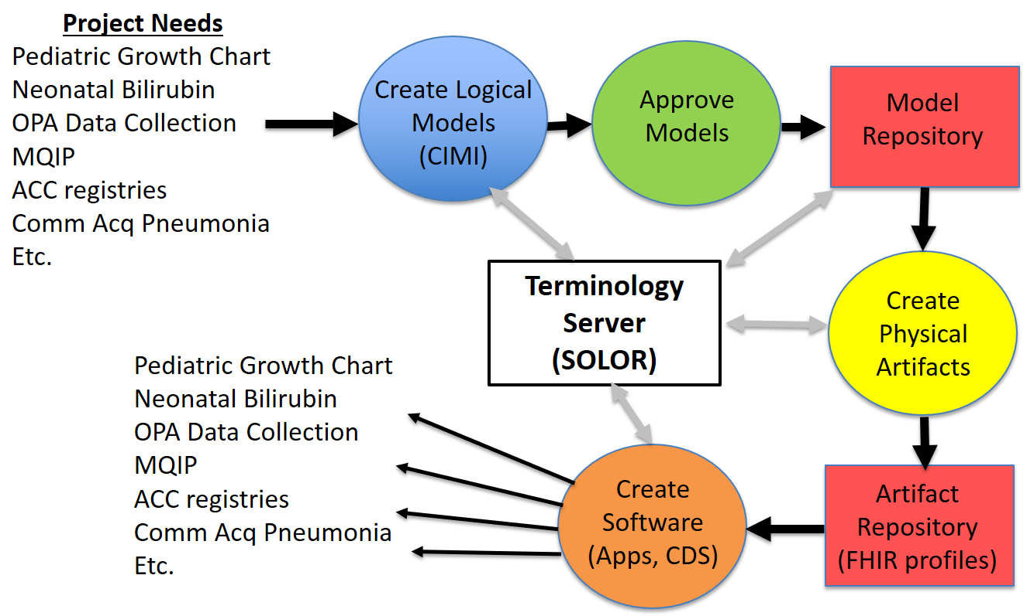

Proposed Solution: Step 3 Apps based on Integrated/reusable Models
CLIM
{SOLOR, FHIM, CIMI, CQF}
HL7/ISO
Balloted
CLIM

Slide 14
High Level Work Breakdown
Governance and Project Criteria
Pilot Project Selection and Development
Skin Assessment / ADL / PC Wound Care
ACOG “Data Element” Definition
CQI/CQF continued steps (underway)
FHIR JET SIGG (underway)
Connectathon outcomes
Health Data Sharing Business Line Wkgp Engagement
Explore EHRS Functional Model
Communication

Slide 15
Attributes of Success
Increased awareness related to Information/Tooling & Integration efforts
Distinction
Utility
Advocacy to insert/jump start with (formal) information Modeling Assets routinely into projects / standards development efforts
Advocacy to support follow-on efforts / Implementation Practicality
Sustain Core SME Framework to refine integration recommendations
Expand / Invest in building upon current SME base
Apply insights / recommendations from Info Modeling Tech Forum into final report
Build out near term, mid term & long term efforts via work breakdown
Assess / layout resourcing implications tied to report
Conduct follow up Modeling Meeting with FHIR colleagues, 15 Sep 2016
Submit final report during Sep 2016 HL7 CIMI Workgroup
Sustain predictable stakeholder contact
Supportive of Integration
Leverage options to sustain co sponsorship engage via Project(s), e.g., Technical Learning Community
Repurpose efforts / Replace building models to build models with active engagements
Acknowledge / enhance usability interests
Acknowledge / enhance SME base, User Community Partnerships & Stakeholder Community Contacts to guide a shifting in commitments & to gauge progress.

Slide 16

Questions
Thank You
The (CIMI-FHIM-SOLOR-CQF) Acronym challenge

Slide 17
Links to Details
Related Documents are viewable and downloadable at
Final Report DOCX https://1drv.ms/w/s!AlkpZJej6nh_k9dQ2qQnRuQM8gbu8A
Final Report PDF https://1drv.ms/w/s!AlkpZJej6nh_k9dQ2qQnRuQM8gbu8A
Preliminary Rpt. DOCX https://1drv.ms/w/s!AlkpZJej6nh_k9YPmsR8Hl6zTlQ0NQ
Preliminary Rpt. PDF https://1drv.ms/w/s!AlkpZJej6nh_k9YPmsR8Hl6zTlQ0NQ
Briefing Slides https://1drv.ms/p/s!AlkpZJej6nh_k9dE-b_DAO8HSNNT6Q
Slides-Notes Pages PDF https://1drv.ms/b/s!AlkpZJej6nh_k9daUH18BNQFOwtNrg
Work Breakdown MPP https://1drv.ms/u/s!AlkpZJej6nh_k9dK5WOB8zkkUuaKgA
Work Breakdown PDF https://1drv.ms/b/s!AlkpZJej6nh_k9dfYSeXPGjTRJ2cAg
Work Breakdown XLSD https://1drv.ms/x/s!AlkpZJej6nh_k9dgBSgLrTfaKYcG2A
CIMI Practitioners’ Guide https://1drv.ms/w/s!AlkpZJej6nh_k6ZUeG7W6TaWcbTZ4Q
HL7 Project Scope Stmt. https://1drv.ms/w/s!AlkpZJej6nh_k9dYlvNWaZ3DLPKSYg

